Slide 1

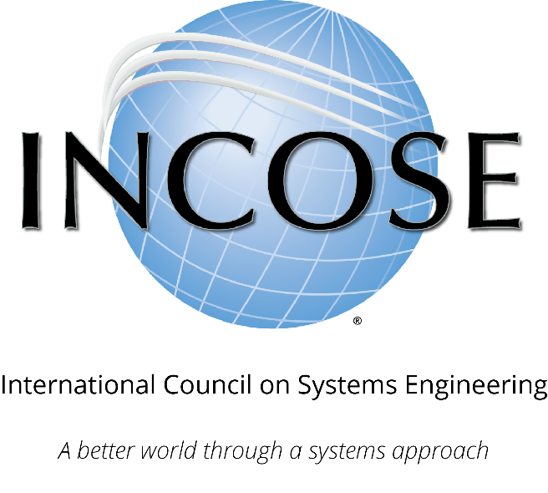
INCOSE
Systems Engineering Professional (SEP)
Certification Program
Program Statistics

Slide 2
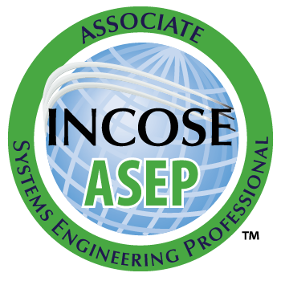
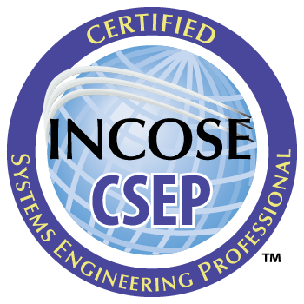
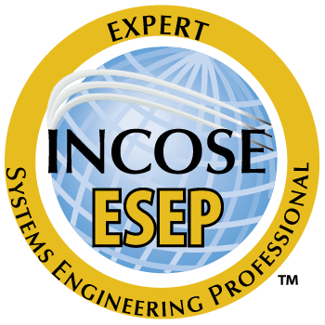
INCOSE SEP Architecture
For wherever you are in your career
Multi-Level Base Credentials
The base ASEP, CSEP, and ESEP credentials cover the breadth of systems engineering at increasing levels of leadership, accomplishments, and experience.
  If you have just started (or plan to start) practicing systems engineering or have recently graduated and are interested in system engineering
  If you are a practicing Systems Engineer with more than five years of systems engineering professional work experience
  If you are a systems engineering leader with recognized systems accomplishments and have many years of systems engineering professional work experience

Slide 3
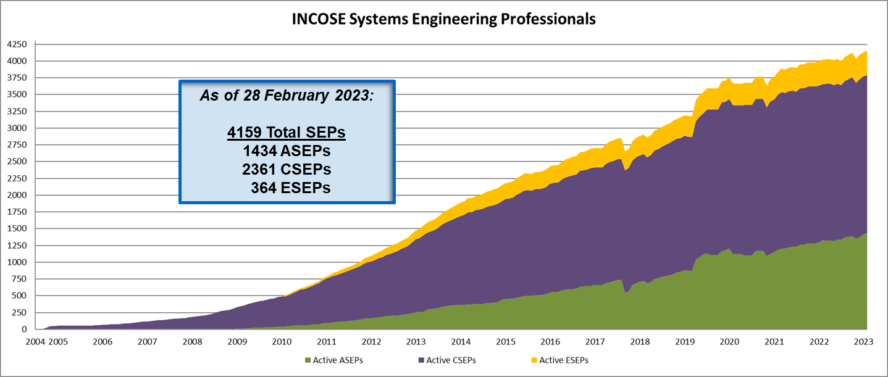
Total SEPs Since 2004

Slide 4
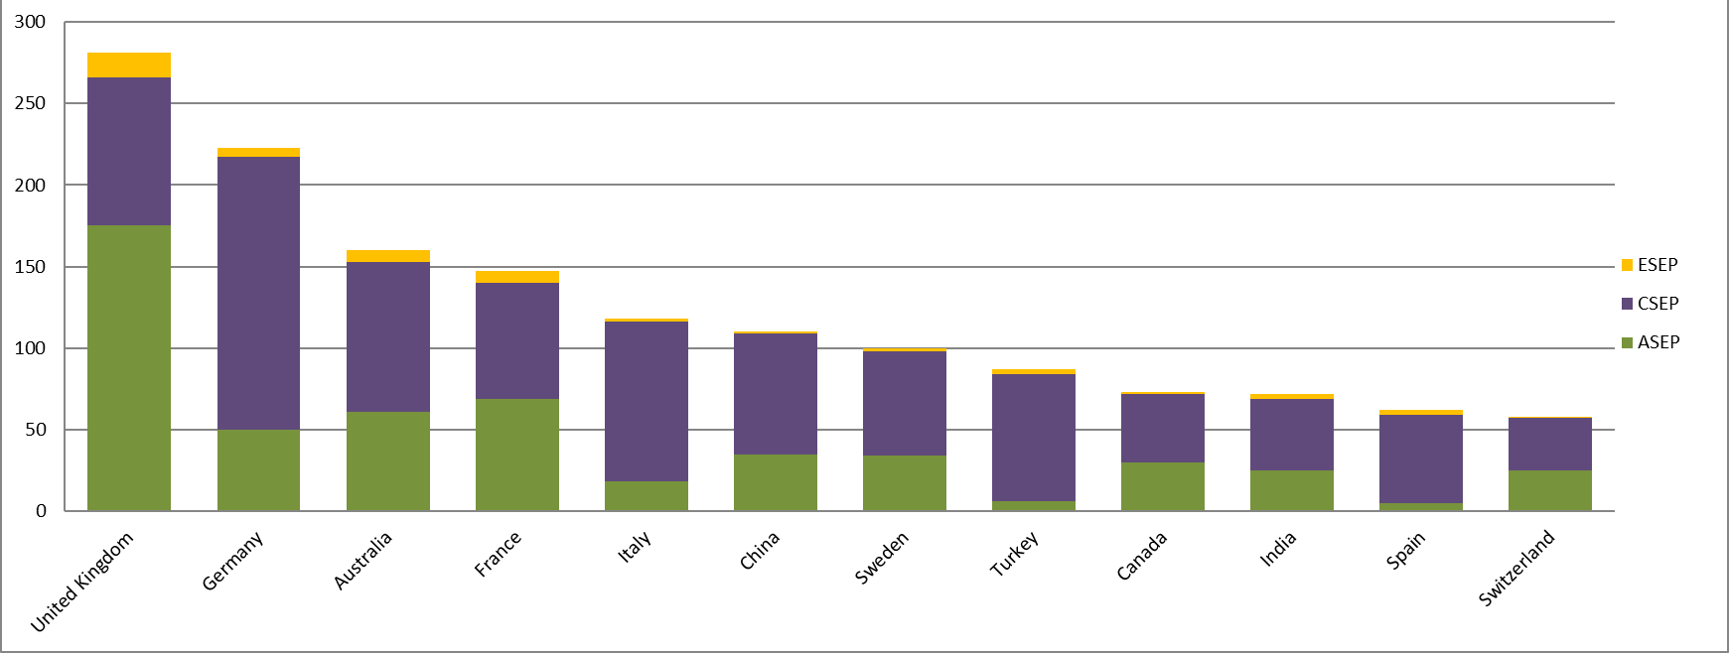
SEPs By Country
Countries (Non-USA) with INCOSE Certified Professionals (Minimum 40)
As of 28 February 2023:
Top Countries w/ Active SEPs
USA 2415 SEPs
(778 ASEP, 1336 CSEP, 301 ESEP)
UK 281 SEPs
Germany 223 SEPs
Australia 160 SEPs
France 147 SEPs

Slide 5
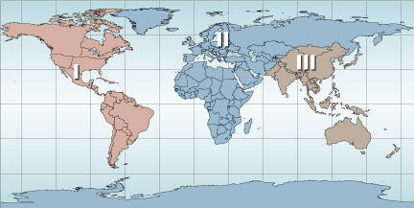
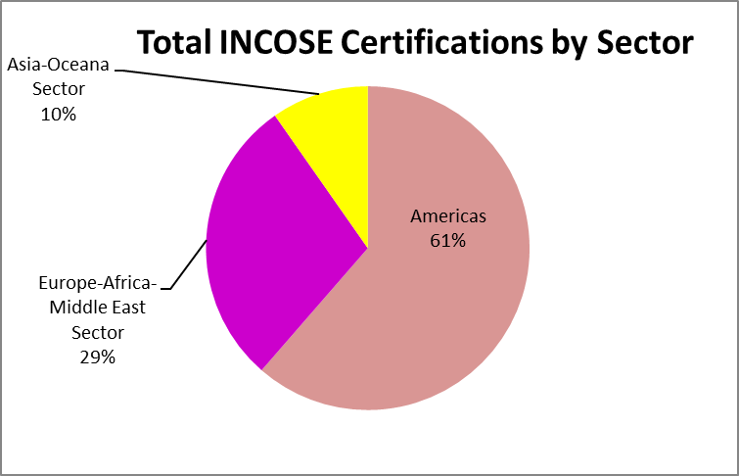
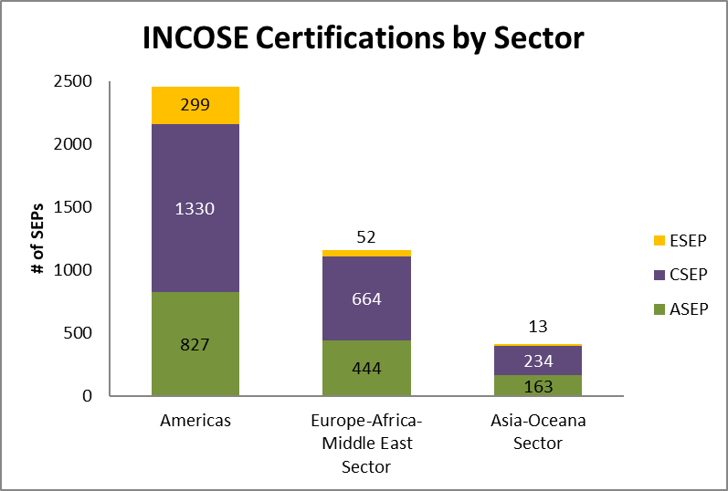
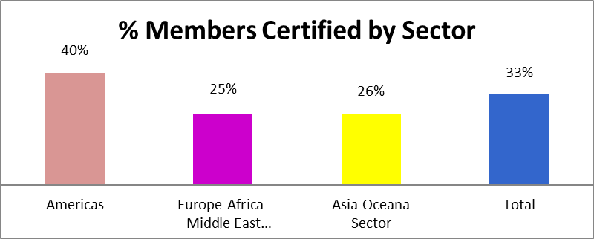
SEPs By Sector
As of February 28, 2023

Slide 6
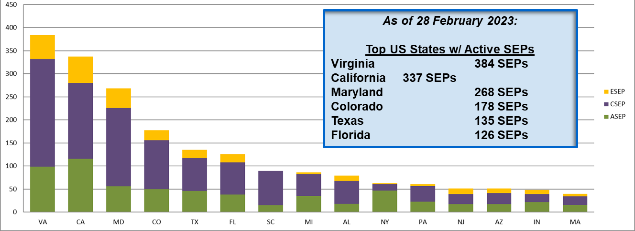
SEPs By US State
USA States with INCOSE Certified Professionals (Minimum 40)

Slide 7
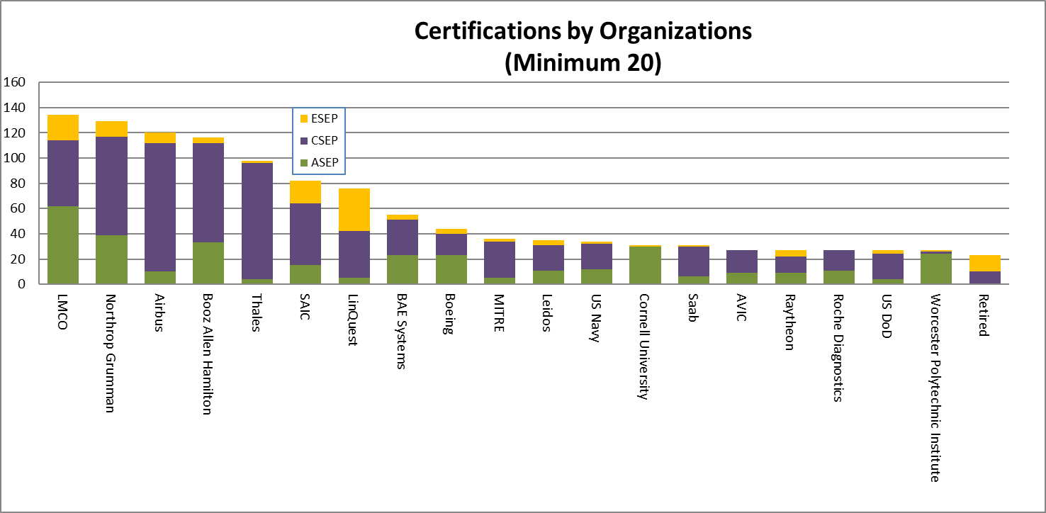
SEPs By Organization
SEPs by Organizations (Minimum 20)
As of 28 February 2023:
Top Organizations w/ Active SEPs
Lockheed Martin 134 SEPs
Northrop Grumman 129 SEPs
Airbus 120 SEPs
Booz Allen Hamilton 116 SEPs

Slide 8













Universities have Certification Agreements
INCOSE and the following Universities have signed agreements to recognize college courses
ACADEMIC EQUIVALENCY

Slide 9

Any Questions?
Certification Office
certification@incose.net
For more information visit
www.incose.org/certification

Slide 10


Learn more at INCOSE.org/certification
©2023 INCOSE. All rights reserved.

